Slide 1



CENE 476 Proposal Presentation Concrete Canoe: Agassiz
By: Carl Wilson
Conrad Senior
Kristen Rasmussen
Logan Grijalva
Stephan Henderson
Date: 12/6/19

Slide 2

1.0 Project Understanding
1.1 Project Purpose
The National Concrete Canoe Competition (NCCC) is an annual competition that is put on by American Society of Civil Engineers (ASCE).
NCCC publishes a Request for Proposal document that all teams must abide by. They also provide teams with two addendums with more details about the Presentation and Durability & Repairs.
These documents are released in the fall prior to the competition in spring.
Figure 1: NCCC Request for Proposals [1]

Slide 3
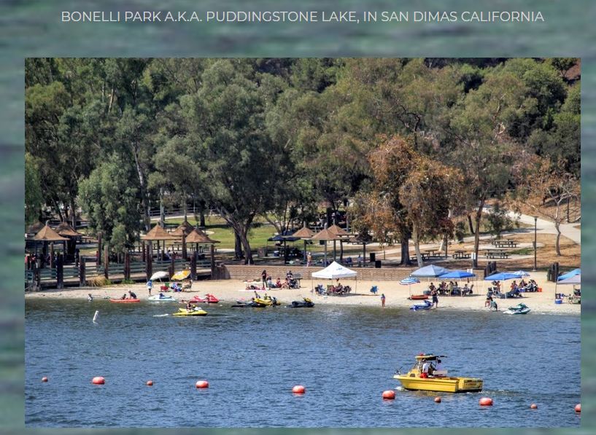
1.0 Project Understanding Cont’d
1.2 Project Background
This year’s PSWC is hosted by
California State Fullerton on April 1-4
Previous Conferences Placement
2017 NAU placed 8th
2018 NAU placed 9th
2019 NAU placed 11th
Figure 2: Puddingstone Lake, San Dimas, California [2]

Slide 4
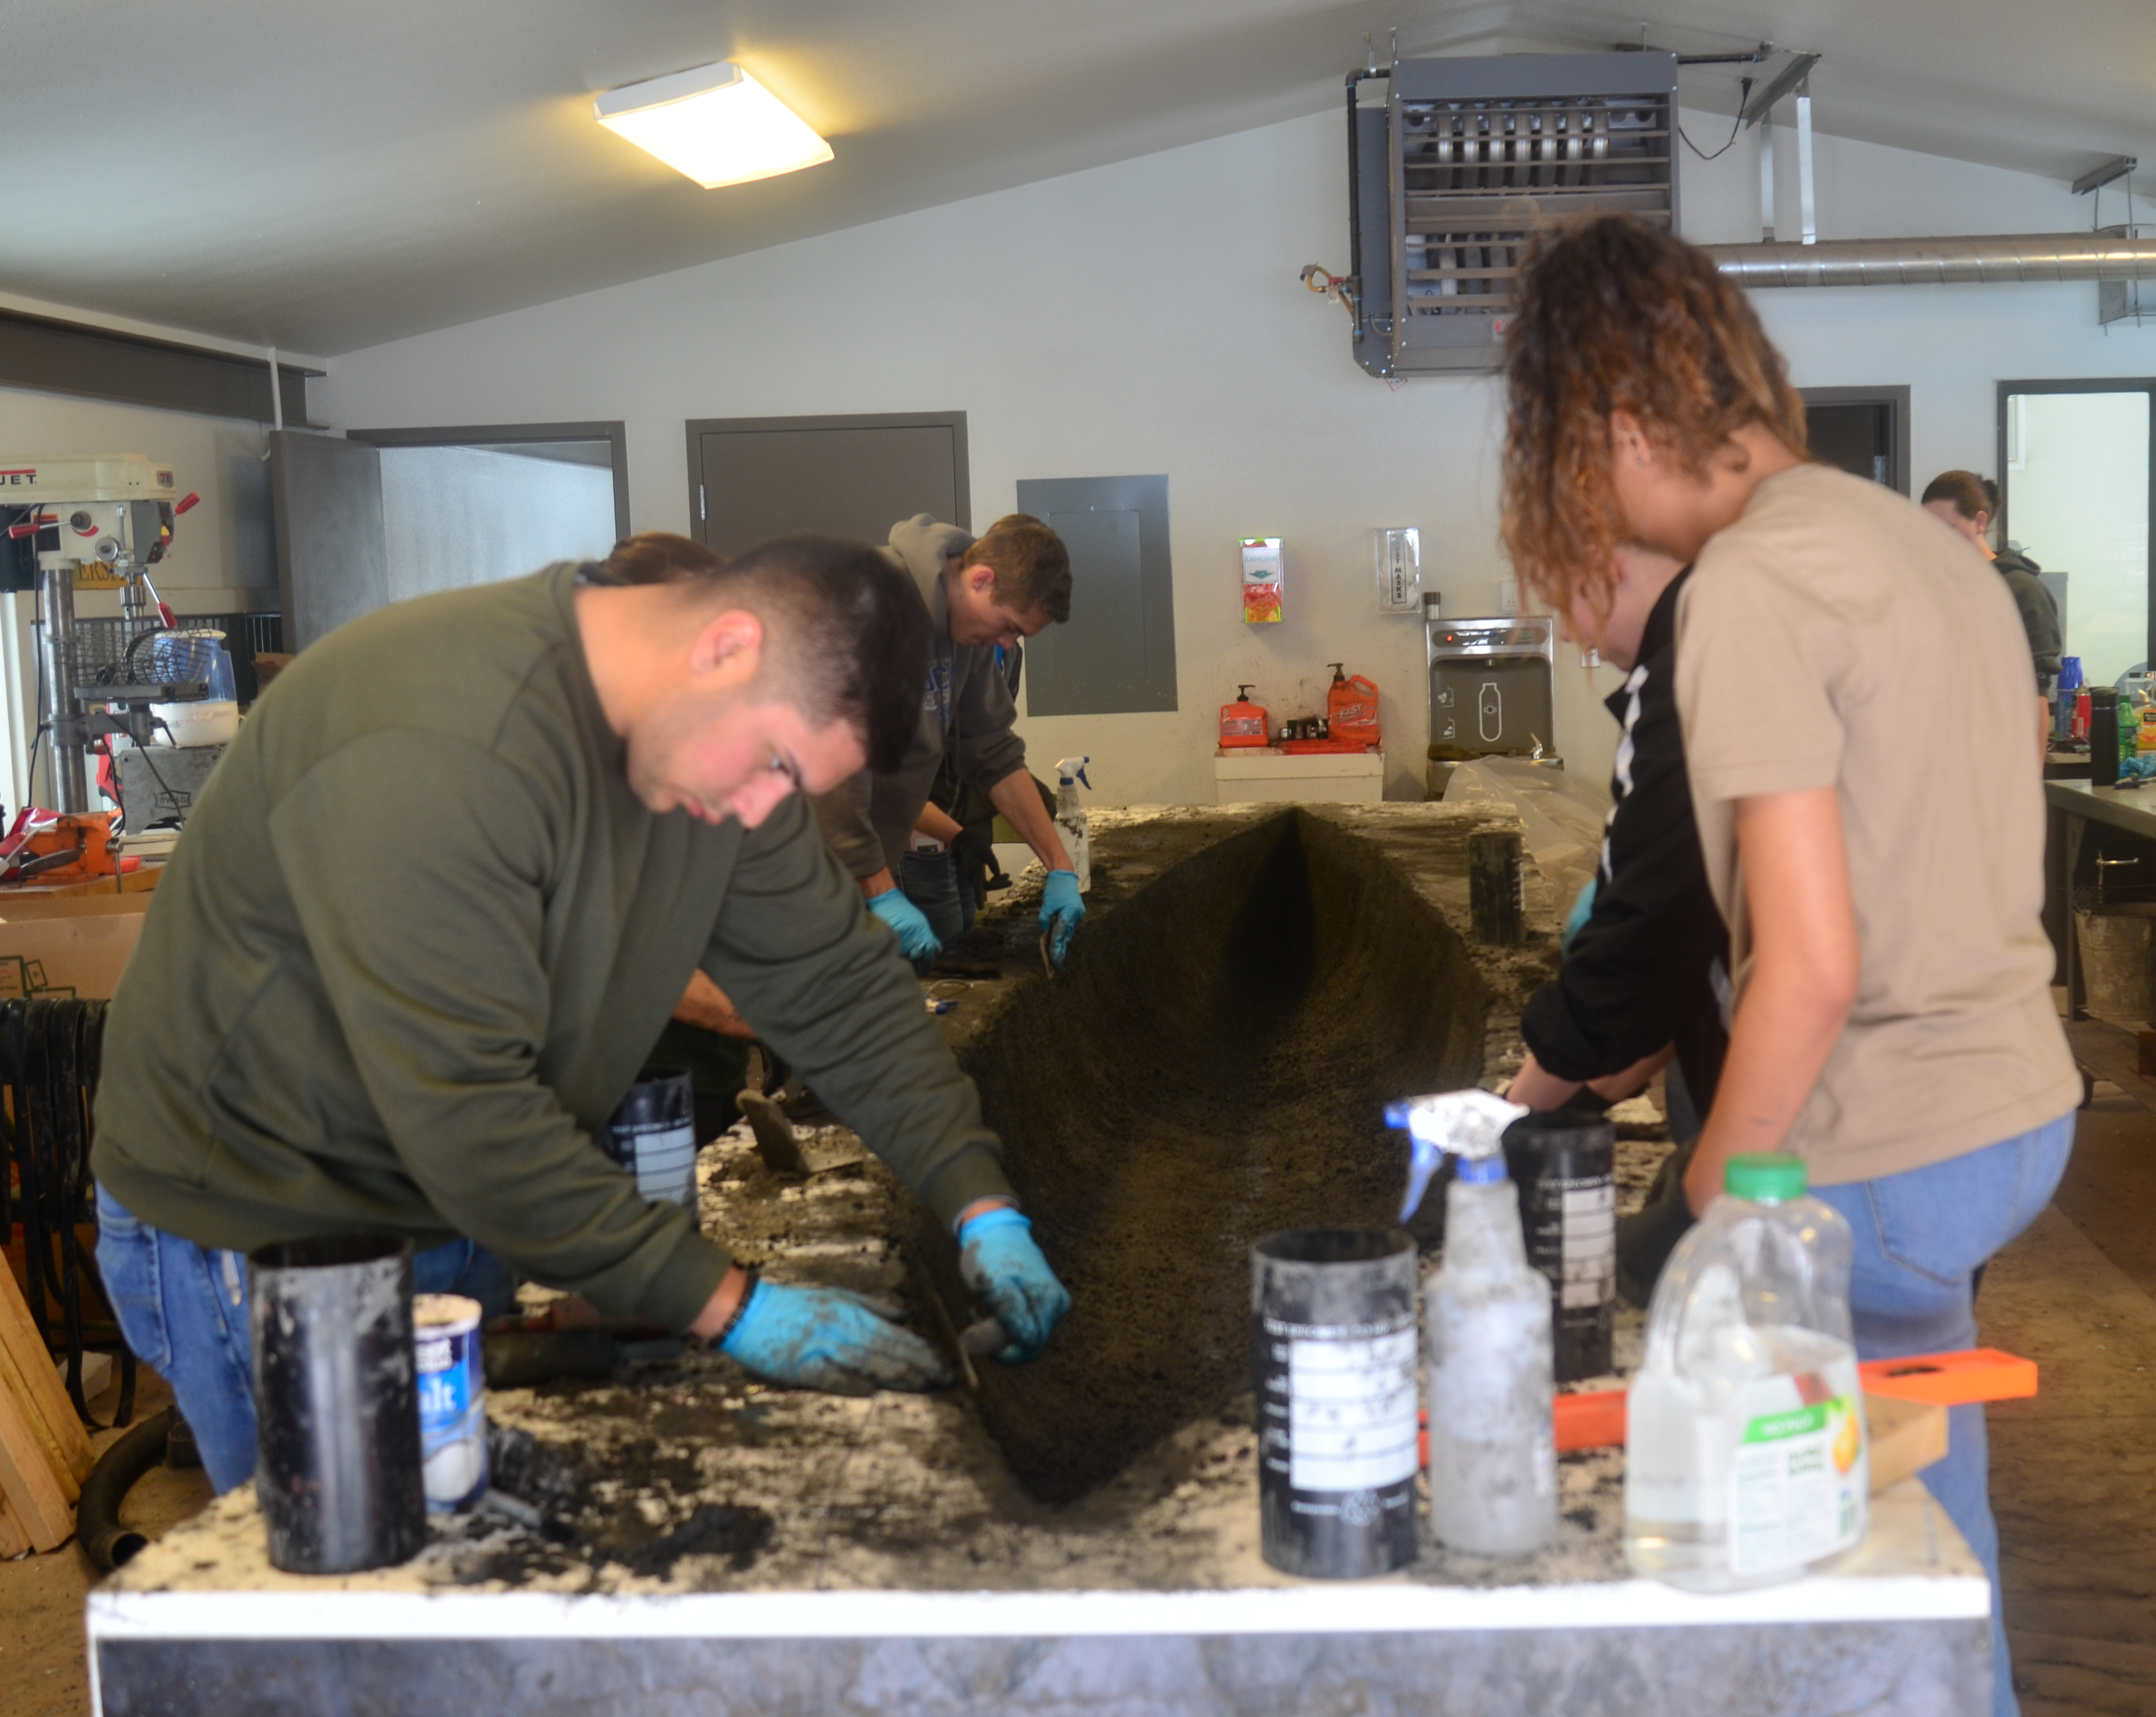
1.0 Project Understanding Cont'd
1.3 Technical Considerations
Hull Design
Concrete Mixture
Structural Capacities
Canoe Construction
Aesthetics
1.4 Potential Challenges
NCCC Rule Changes
Mix Design
Post Tensioning
Mix Placement
Figure 3: Volcanoe Final Pour Day
Photo Credit: Carl Wilson

Slide 5

1.0 Project Understanding Cont'd
1.5 Stakeholders
Northern Arizona University
Northern Arizona University's College of
Engineering, Informatics, and Applied Sciences
(CEIAS)
NAU ASCE Student Chapter
Client – Mark Lamer (Engineering Professor)
Team Sponsors
Figure 4: NAU Logo[3]

Slide 6
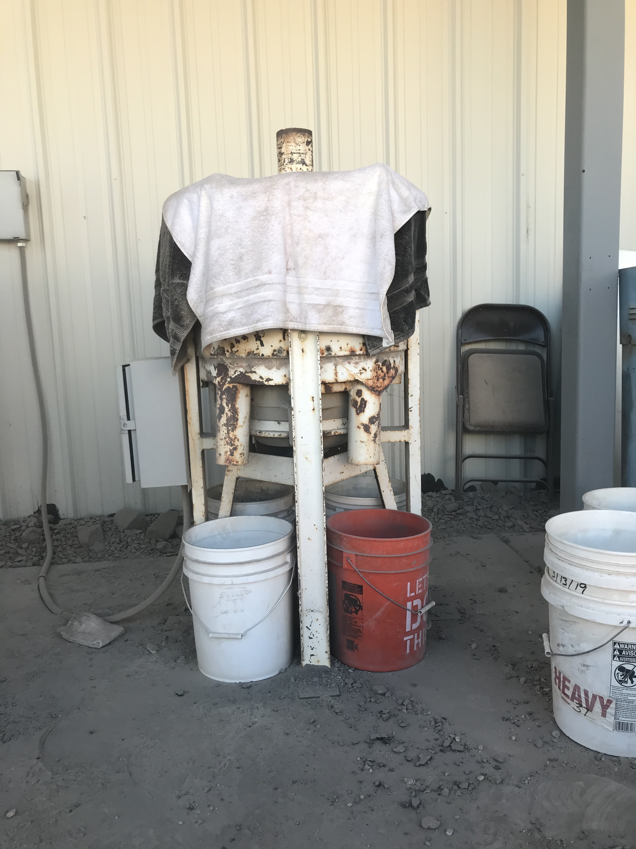
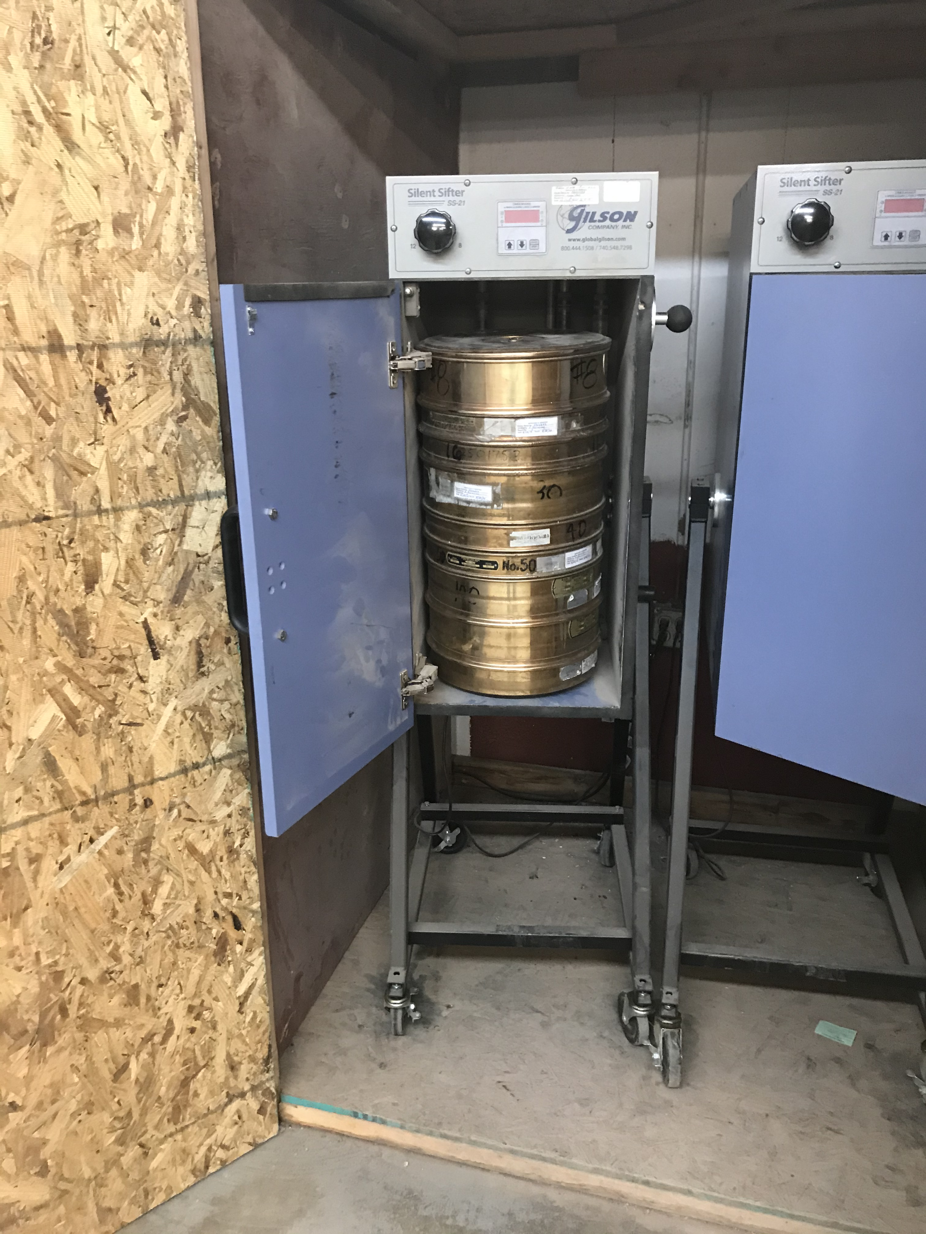
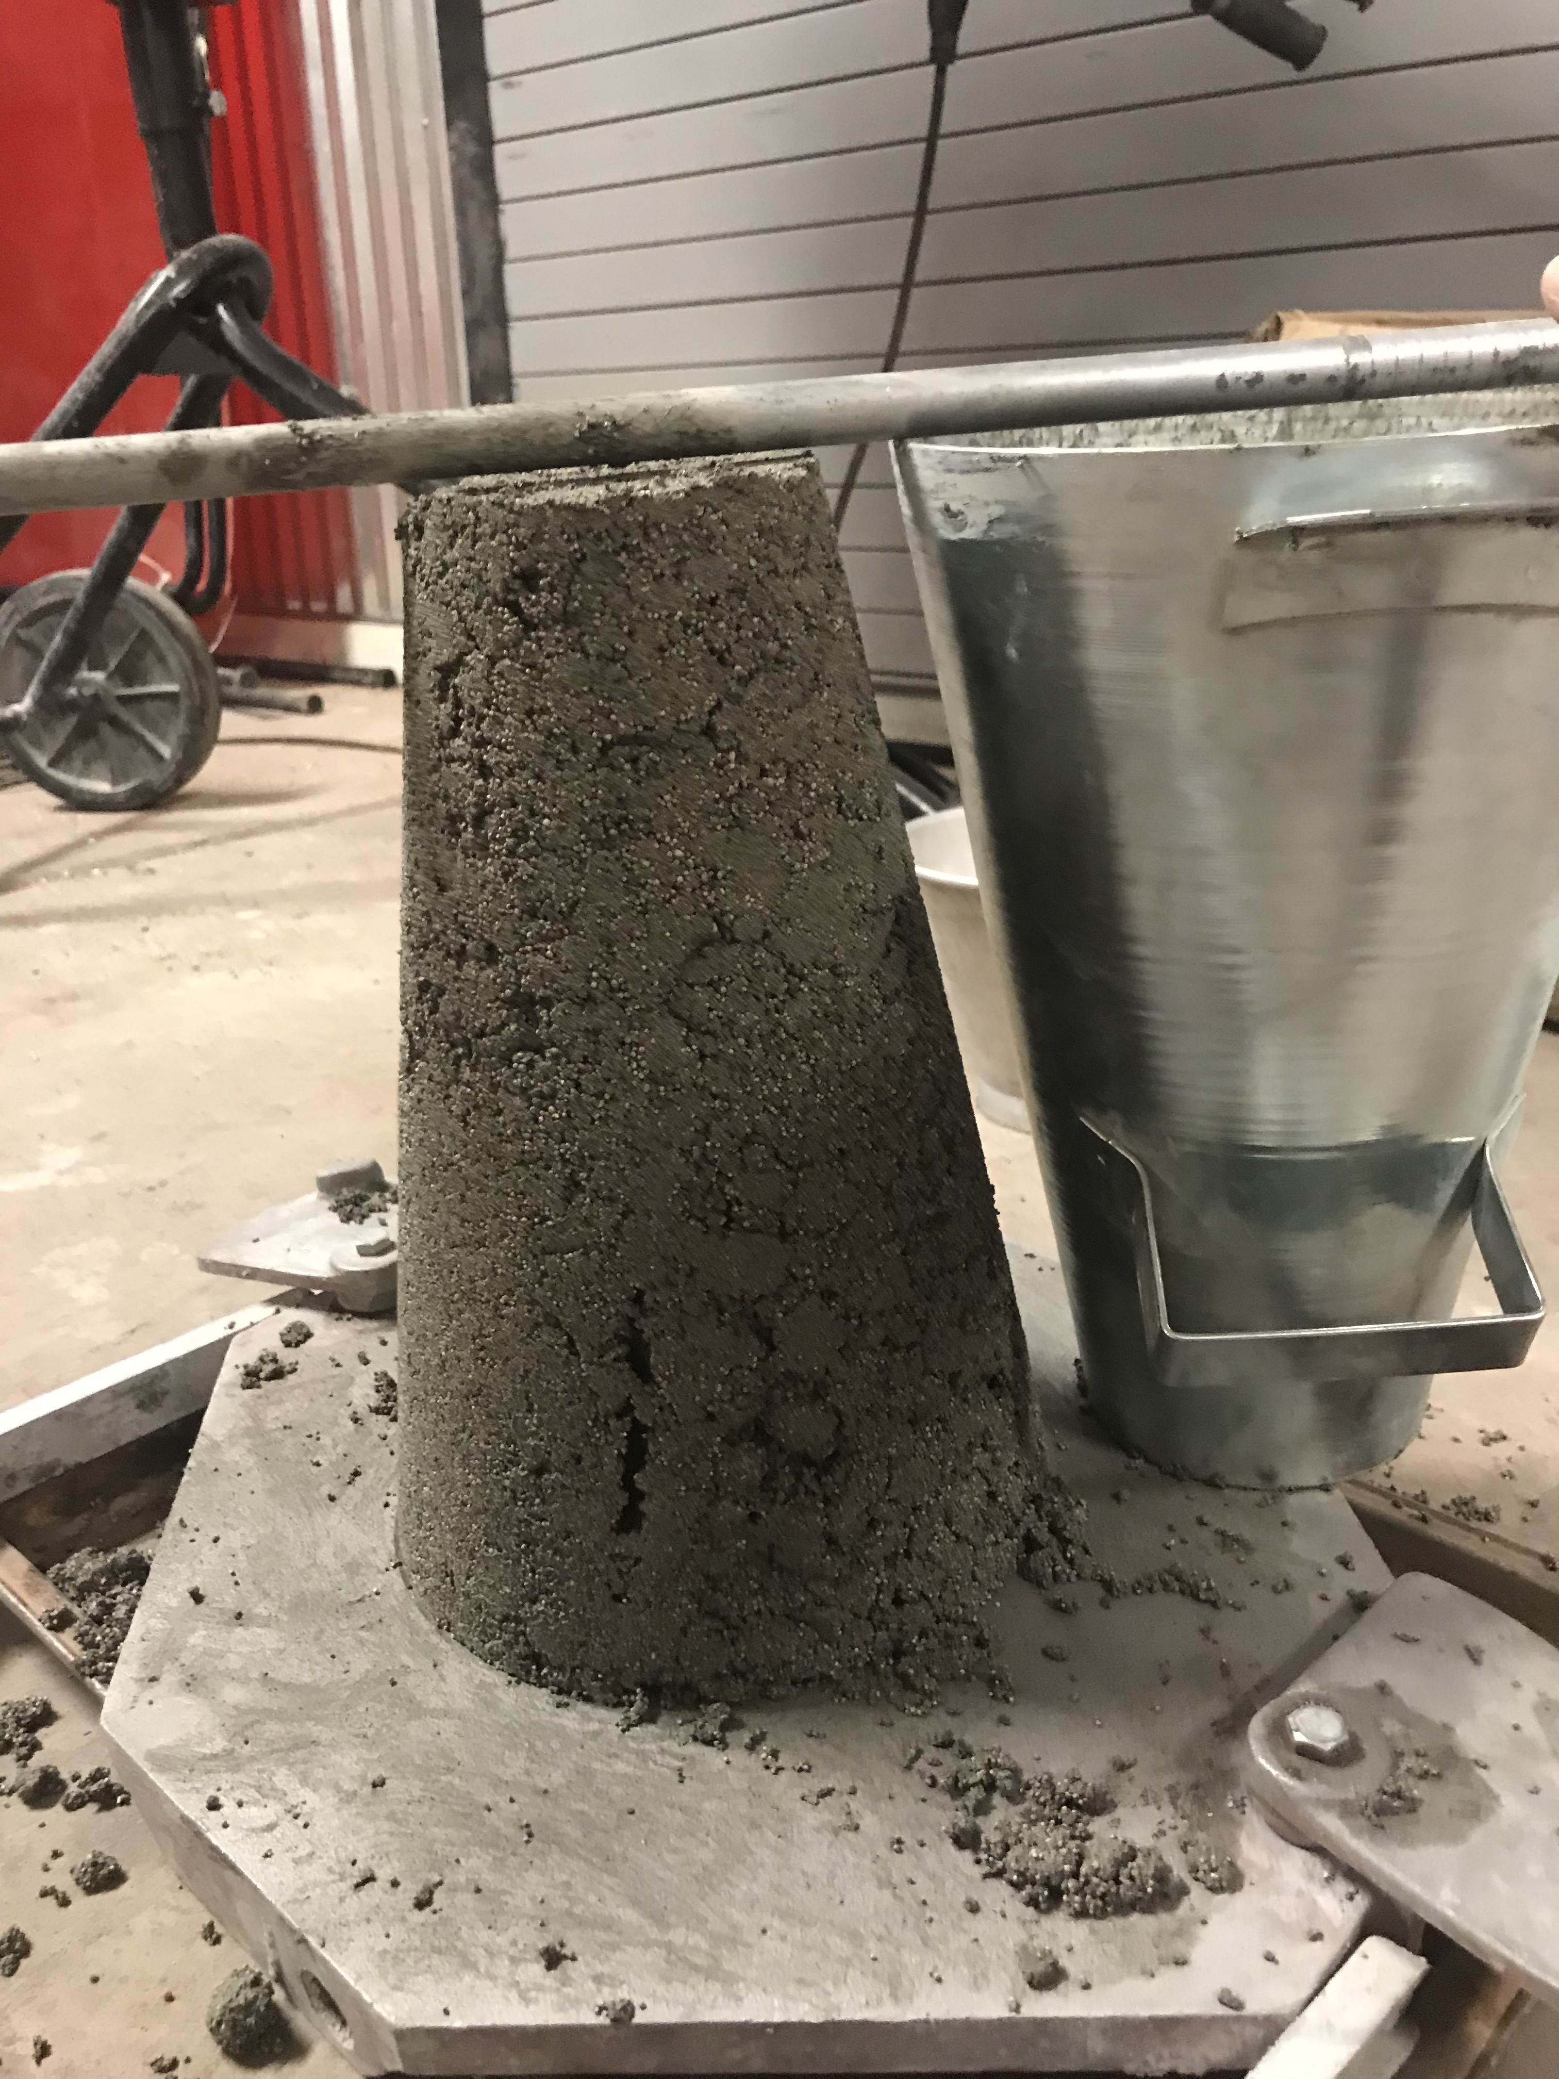
2.0 Scope of Services
Task 1: Mix Design
Task 1.1 Material Research
Task 1.2 Material Acquisition
Task 1.3 Initial Mix Design
Task 1.4 Initial Mix Testing
Task 1.5 Alternative Mix Design Testing
Task 1.6 Final Mix
Figure 5: Barrell Crusher
Photo Credit: Conrad Senior
Figure 6: Sieve Gradation
Photo Credit: Conrad Senior
Figure 7: Slump Test
Photo Credit: Conrad Senior

Slide 7
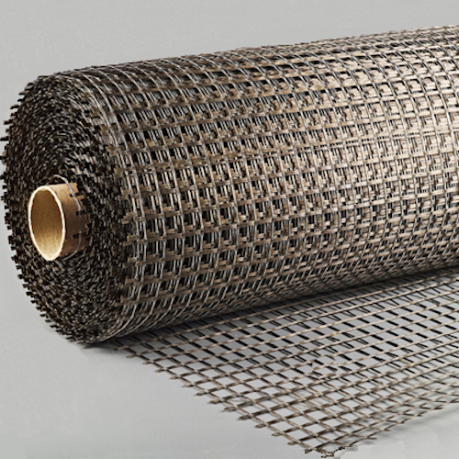
2.0 Scope of Services Cont'd
Task 2: Hull Design
Task 3: Structural Design
Task 3.1 Calculation
Ex. Buoyancy, Moment,
Shear, Cracked Analysis
Task 3.2 Mesh Selection
Task 3.3 Material Testing
Task 3.4 Post - Tensioning Placement
Figure 8: Basalt Mesh [5]

Slide 8
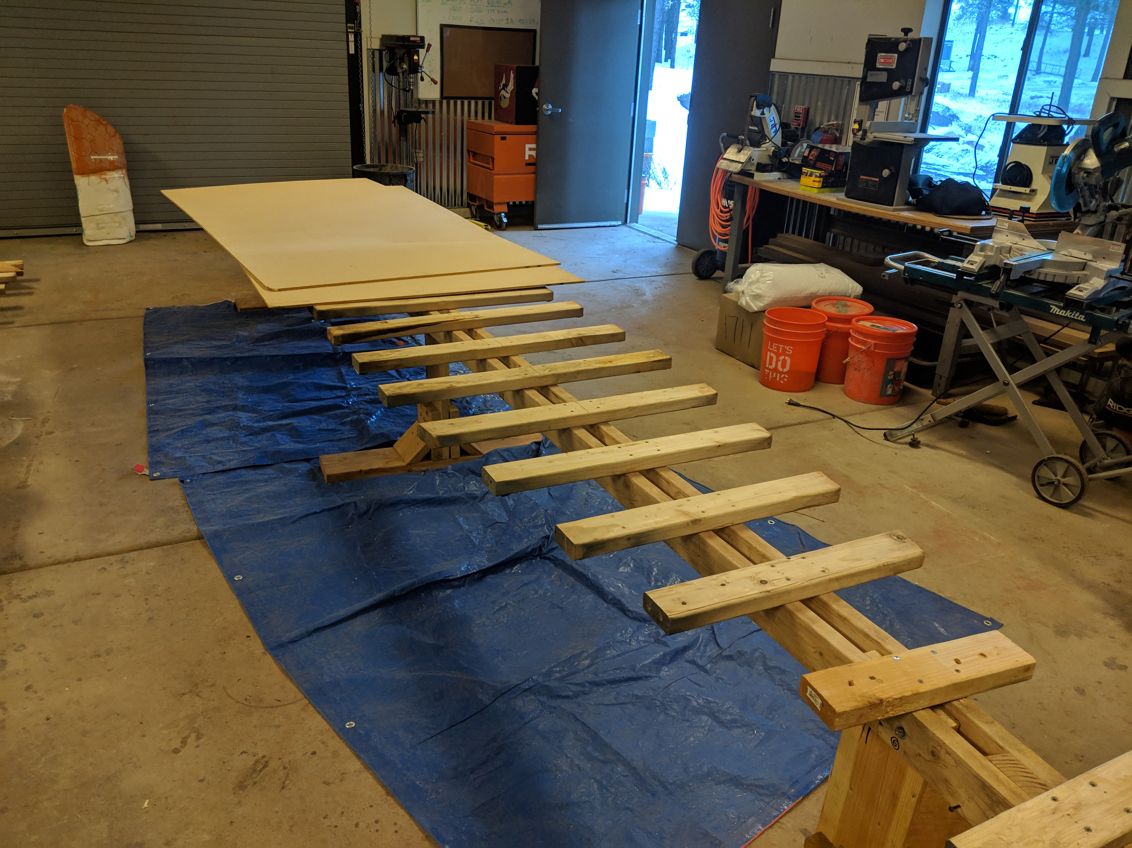
2.0 Scope of Services Cont'd
Task 4: Construction
Task 4.1 Set Up
Task 4.2 Practice Pour
Task 4.3 Final Pour
Figure 9: Male Mold Pour Table
Photo Credit: Conrad Senior

Slide 9
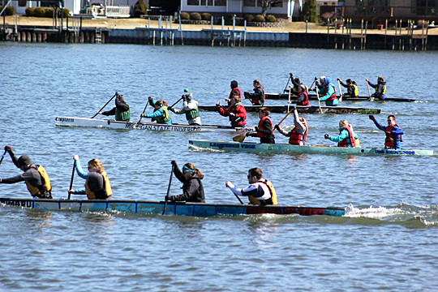
2.0 Scope of Services Cont'd
Task 5: Conference
Task 5.1 Presentation
Task 5.2 Report
Task 5.3 Races
Task 5.4 Display
Task 6: Capstone Deliverables
Task 6.1 30% Report and Presentation
Task 6.2 60% Report and Presentation
Task 6.3 90% Report and Presentation
Task 6.4 Final Report, Presentation, Website
Figure 10: 2017 PSWC Concrete Canoe Race
Photo Credit: Conrad Senior

Slide 10
2.0 Scope of Services Cont'd
Task 7: Project Impacts
Task 7.1 Social
Task 7.2 Environmental
Task 7.3 Economics
Task 8: Project Management
Task 8.1 Scheduling
Task 8.2 Meetings (GI/TA/Team)
Task 8.3 Fundraising

Slide 11
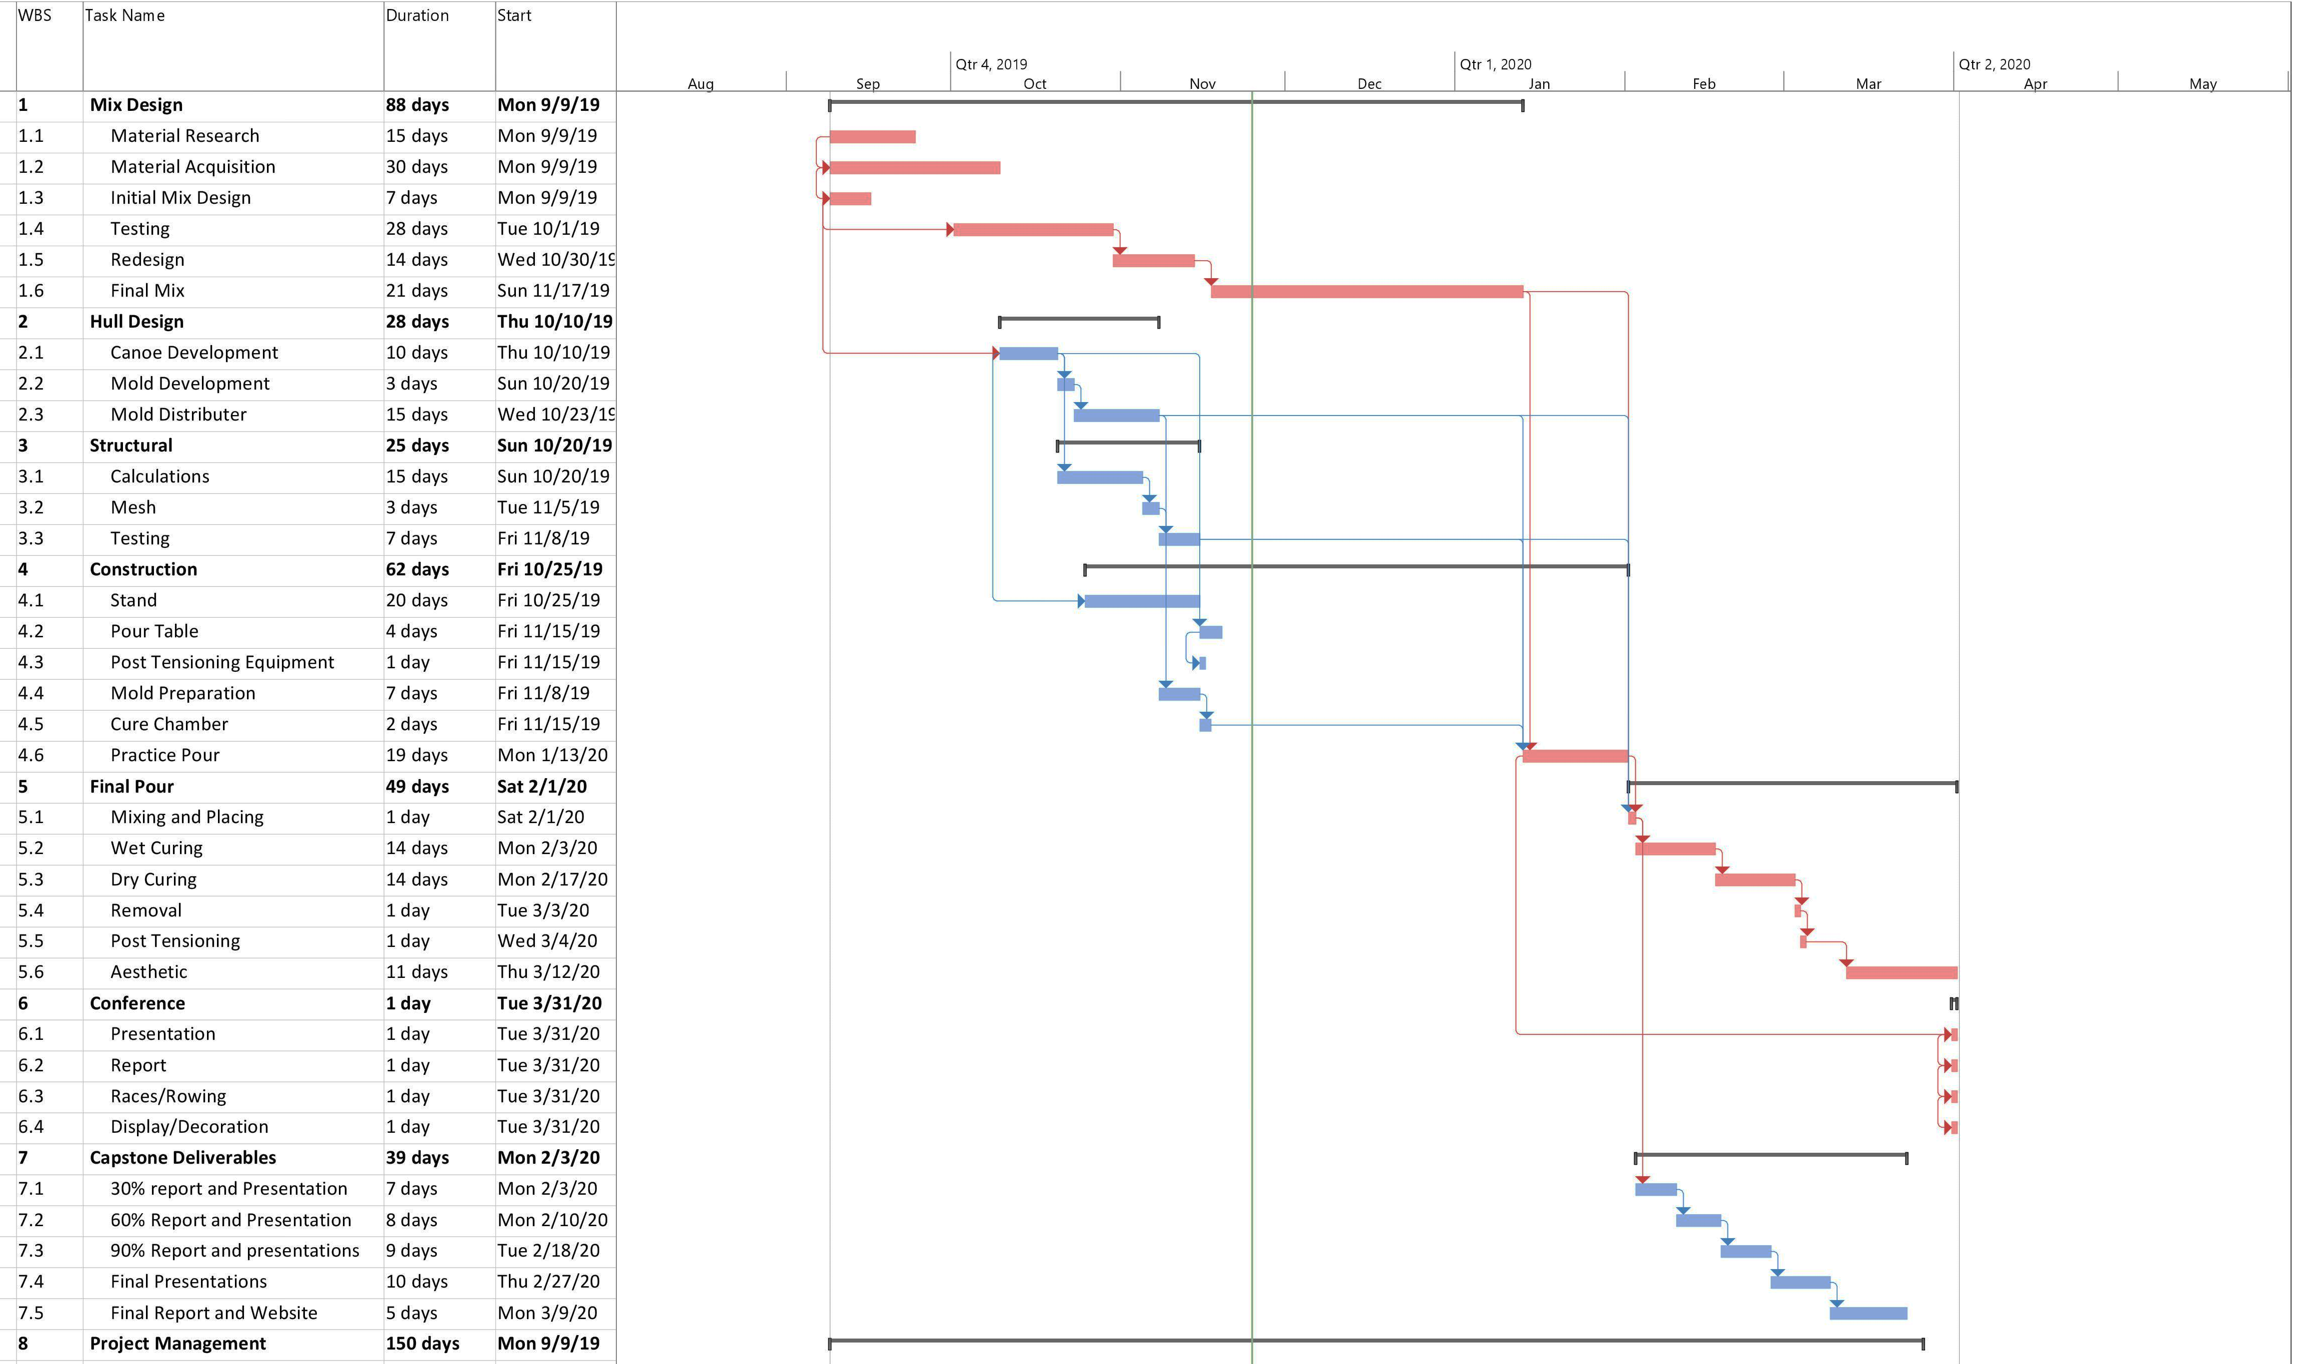
Critical Path: 204 Days

Slide 12
4.0 Staffing Personnel
Table 1: Staff Personnel Summary
Staff Summary
Title | Abbreviation
Project Manager | PM
Structural Engineer | SE
Design Engineer | DE
Materials Engineer | ME
Project Engineer | PE
Engineer in Training | EIT
Sub-Contractor | SUB
Lab Technician | LAB

Slide 13
4.0 Staffing Plan Cont’d
 | SE | DE | ME | PM | LAB | PE | EIT | SUB | Task Total (Hours)
Task 1: Mix Design | 0 | 13 | 78 | 19 | 49 | 45 | 39 | 0 | 243
Task 2: Hull Design | 10 | 30 | 0 | 2 | 0 | 10 | 0 | 0 | 52
Task 3: Structural Design | 55 | 15 | 5 | 2 | 10 | 35 | 10 | 2 | 134
Task 4: Construction | 21 | 65 | 48 | 18 | 0 | 44 | 5 | 92 | 293
Task 5: Conference | 15 | 15 | 5 | 25 | 0 | 25 | 25 | 40 | 150
Task 6: Capstone Deliverables | 16 | 16 | 16 | 8 | 0 | 16 | 8 | 0 | 80
Task 8: Project Management | 8 | 8 | 8 | 38 | 2 | 18 | 0 | 5 | 87
TOTAL HOURS | 125 | 162 | 160 | 112 | 61 | 193 | 87 | 139 | 1039

Slide 14
5.0 Cost of Engineering Services
Table 2: Cost of Engineering Services
Table 3: Cost of Engineering Services Cont'd
Engineering Services Cost Estimate
 | Classification | Quantity | UM | Rate ($/UM) | Cost
1.0 Personnel
 | PM | 112 | HR | 175 | $ 19,600
 | SE | 125 | HR | 150 | $ 18,750
 | DE | 162 | HR | 150 | $ 24,300
 | ME | 160 | HR | 150 | $ 24,000
 | PE | 193 | HR | 150 | $ 28,950
 | EIT | 87 | HR | 110 | $ 9,570
 | SUB | 139 | HR | 85 | $ 11,815
 | TECH | 61 | HR | 75 | $ 4,575
Sub-Total |  |  |  |  | $ 141,560
2.0 Travel
 | Conference Travel | 453 | MI | 0.58 | $ 263
 | Conference Registration | 5 | EA | 125 | $ 625
 | Conference Lodging (2 Rooms) | 3 | Nights | 450 | $ 1,350
Sub-Total |  |  |  |  | $ 2,238
Engineering Services Cost Estimate Cont.
 | Classification | Quantity | UM | Rate ($/UM) | Cost
3.0 Lab Facilities
 | Concrete Laboratory | 20 | HR | 30 | $ 600
 | Field Station | 30 | HR | 25 | $ 750
Sub-Total |  |  |  |  | $ 1,350
4.0 Supplies
 | Cementitious Material | 10 | CF | 5 | $ 50
 | Aggregates | 12 | CF | 6 | $ 72
 | Admixtures | 3 | GAL | 10 | $ 30
 | Basalt Mesh | 13 | SY | 10 | $ 130
 | 1/8" Inch Cable | 108 | LF | 0.32 | $ 35
 | Cable Sleeve | 108 | LF | 0.11 | $ 12
 | Transportation Device | 1 | LS | 75 | $ 75
 | Display | 1 | LS | 125 | $ 125
Sub-Total |  |  |  |  | $ 528
5.0 Sub-Contract
 | Mold | 2 | EA | 900 | $ 1,800
Sub-Total |  |  |  |  | $ 1,800
6.0 Total |  |  |  |  | $ 147,476

Slide 15
References
[1]NCCC, Asce.org, 2019. [Online]. Available: https://www.asce.org/uploadedFiles/Conferences_and_Events/Event_Subpages/Content_Pieces/2020_nccc_request_for_proposals-rules.pdf. [Accessed: 26- Nov- 2019].
[2]"Boating Information", FRANK G. BONELLI REGIONAL PARK, 2019. [Online]. Available: https://www.bonellipark.org/boating.html. [Accessed: 26- Nov- 2019].
[3]Visual Identity Guide. (2019). University Marks | Visual Identity Guide. [online] Available at: https://nau.edu/visual-identity-guide/university-marks/ [Accessed 3 Dec. 2019].
[4]Systems, S., Policy, P., Store, B., Blog, B., BLOG, B., FAQs, B., Codes, B., Store, B., PDF, B., Form, B., 8422, P. and NICK, E. (2019). Basalt Reinforcement Mesh Geo-Grid is better than steel. [online] Basalt Mesh. Available at: https://basalt-mesh.com/ [Accessed 3 Dec. 2019].
[5]Canoeing.com. (2019). Canoe Design · Canoeing.com. [online] Available at: http://canoeing.com/canoes/canoe-design/ [Accessed 3 Dec. 2019].

Slide 16
Thank You!

